Slide 1
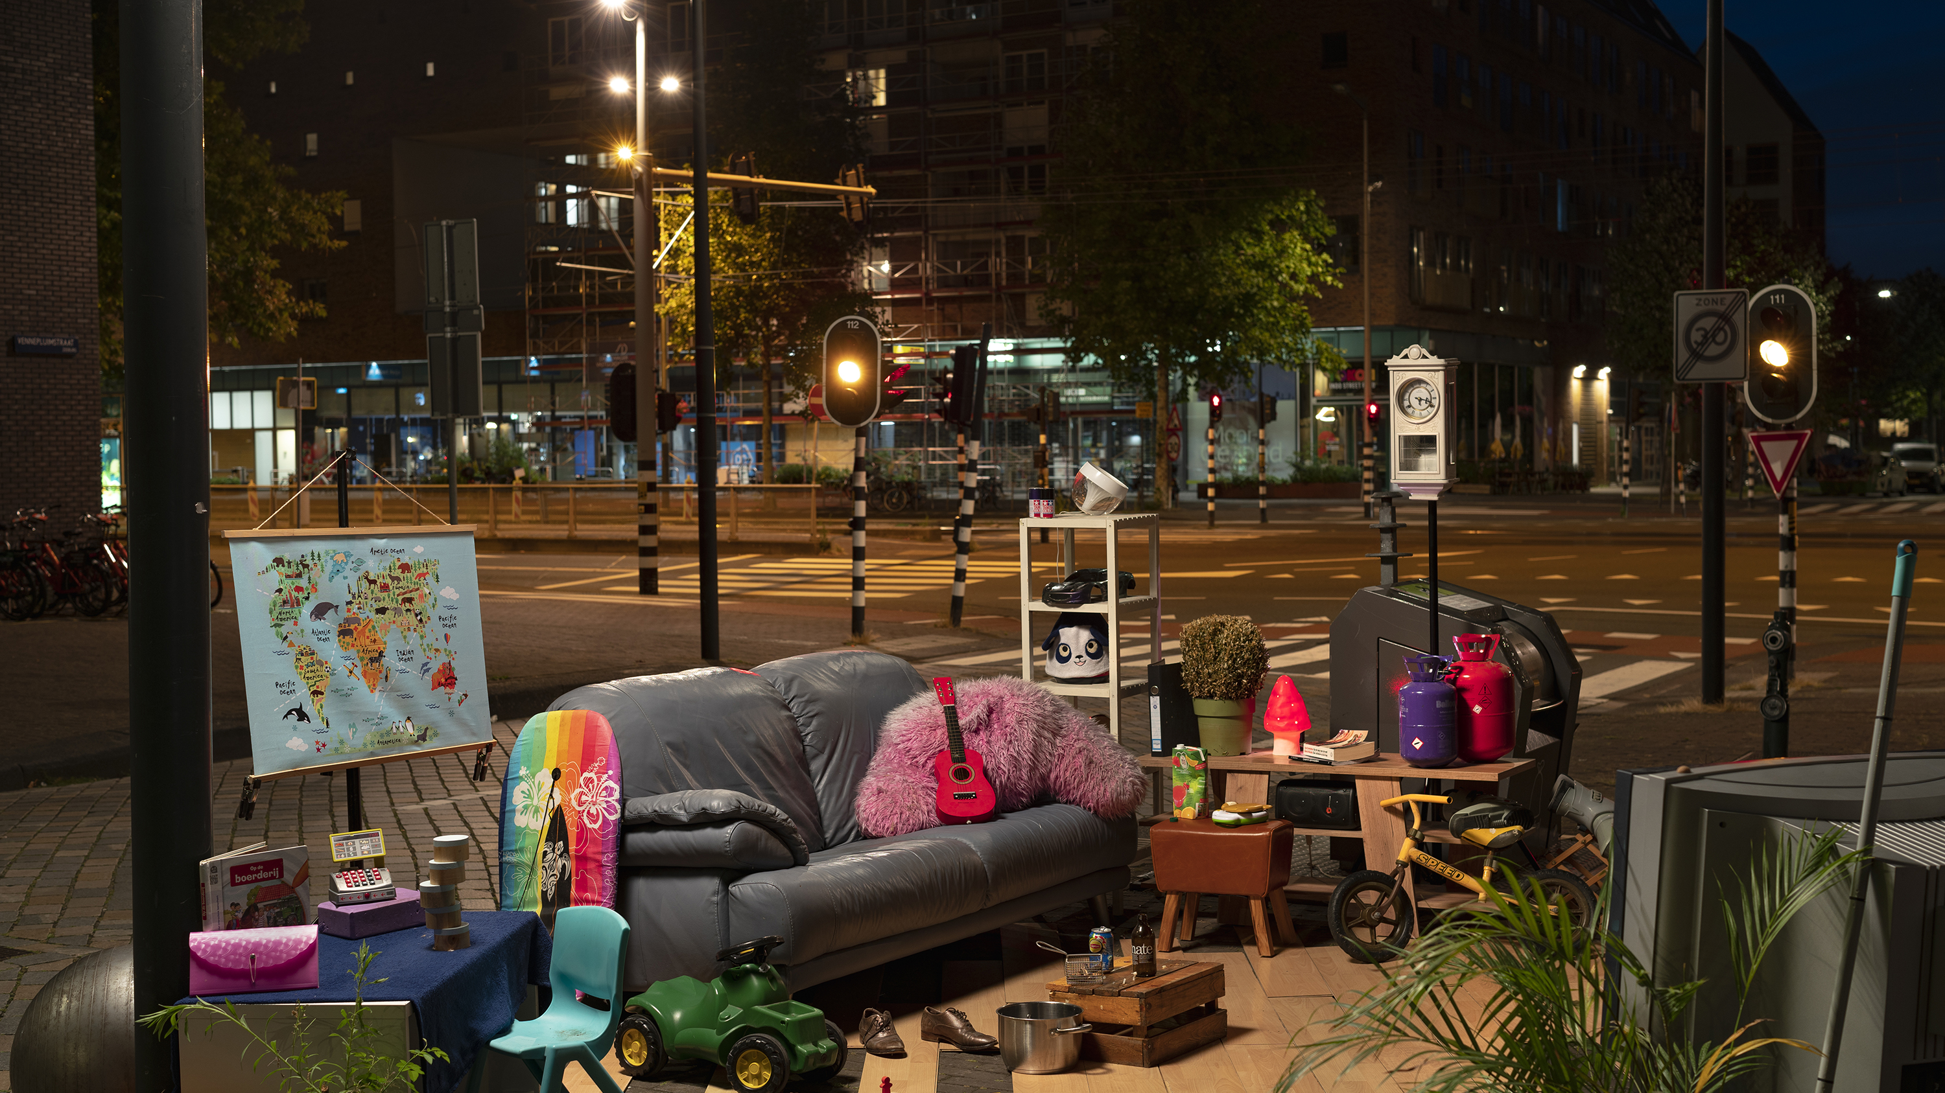

Creative Challenge

Slide 3
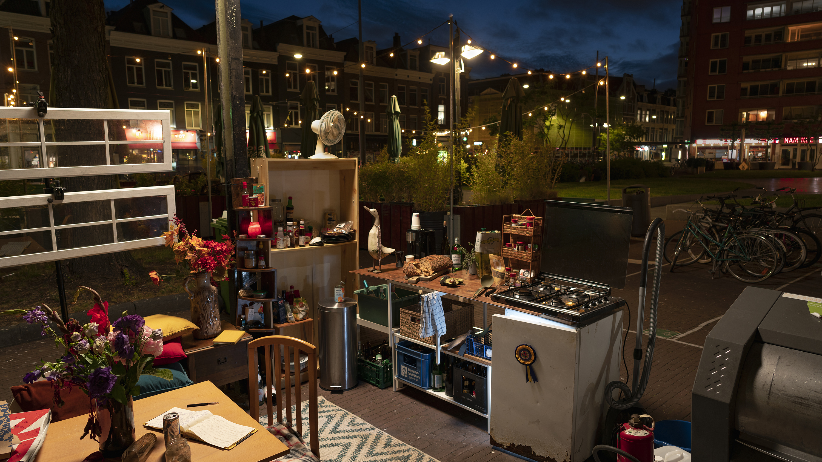

Slide 4
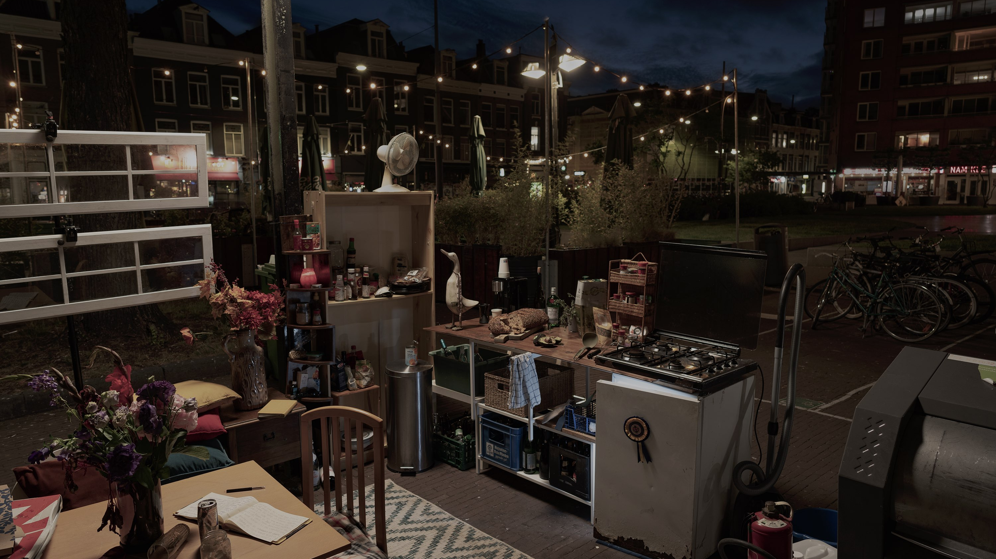
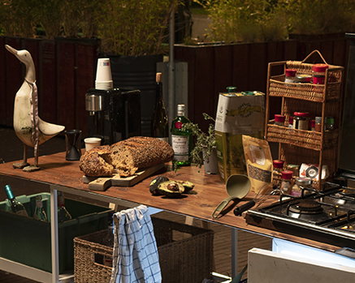
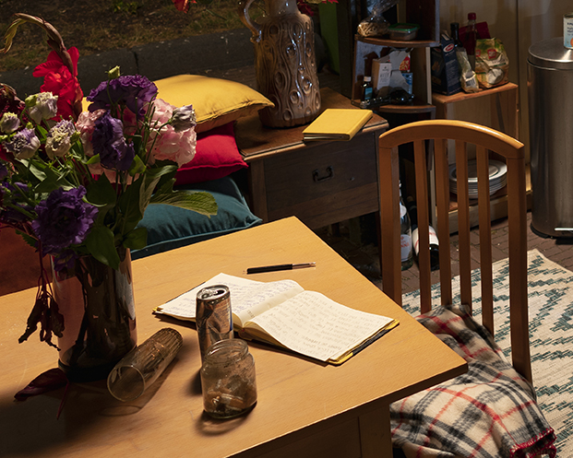

Slide 6
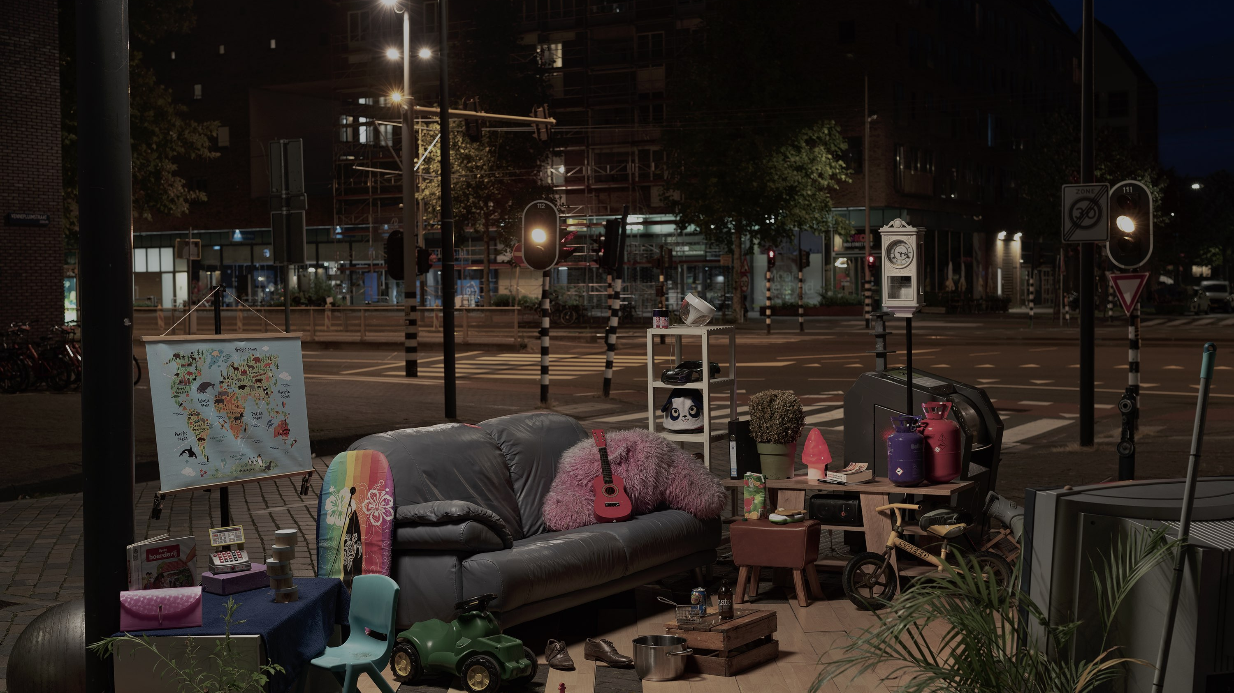
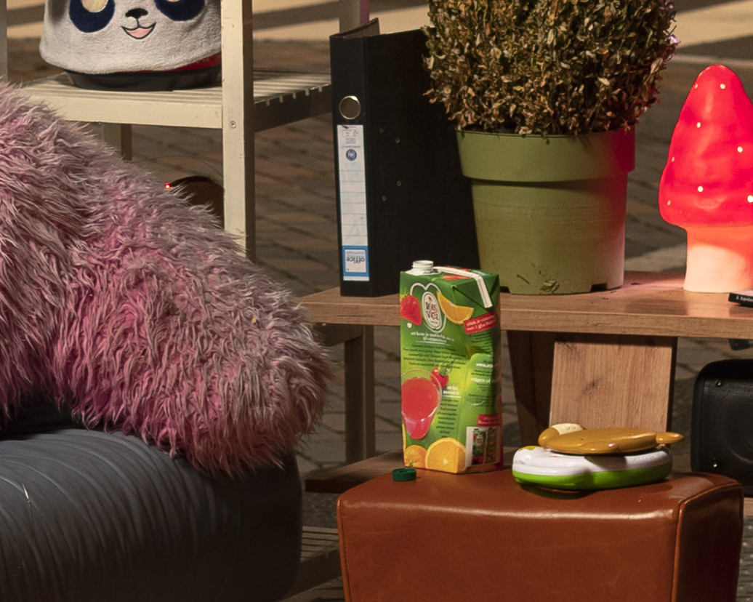
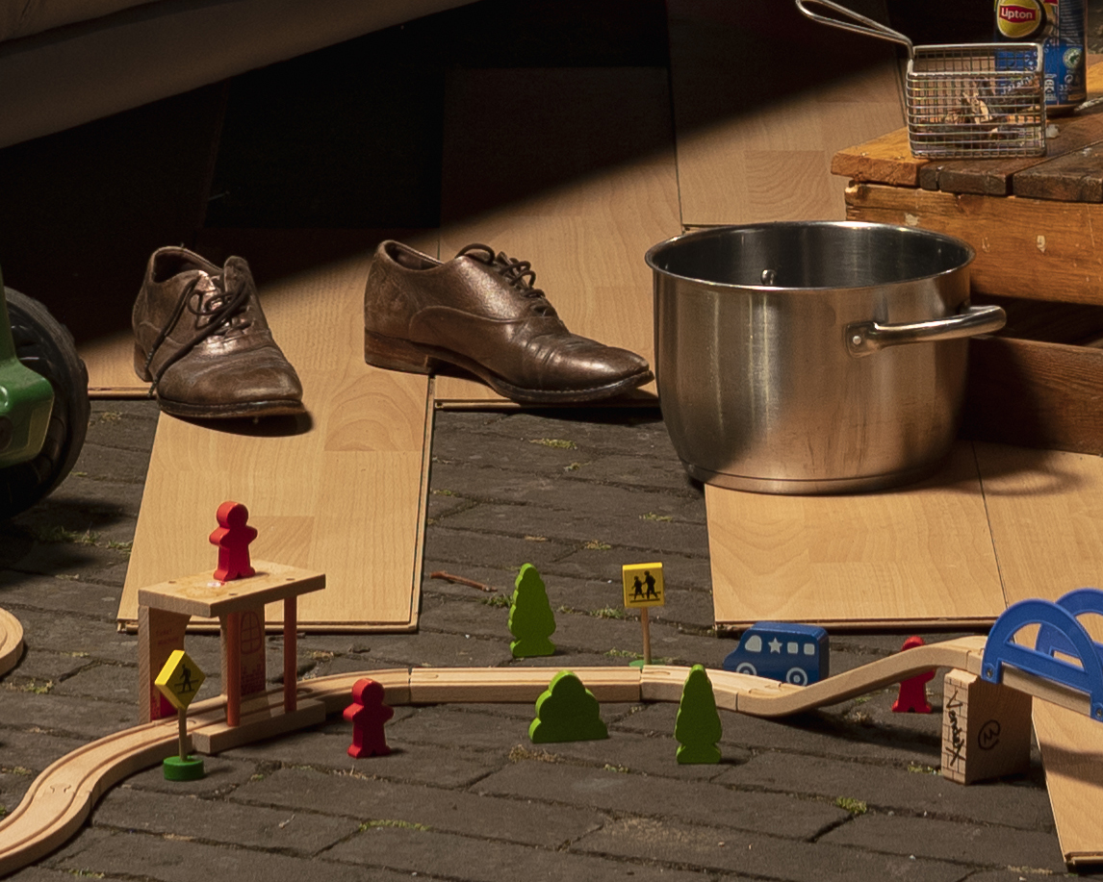

Slide 7
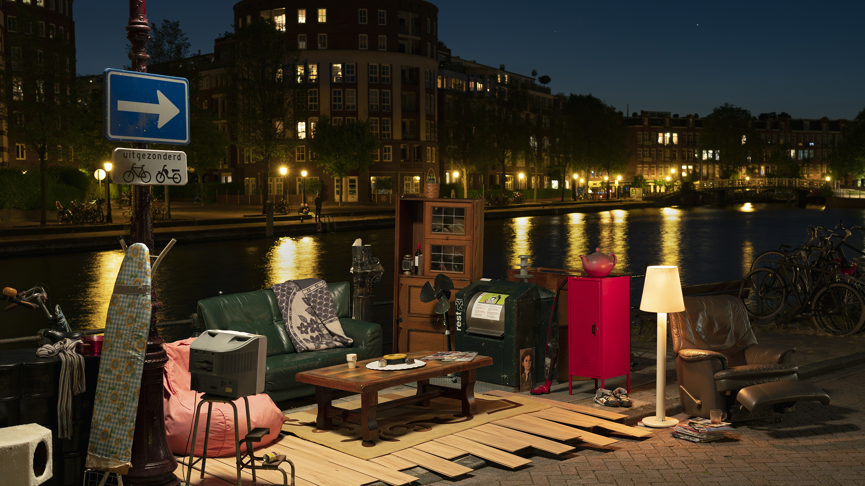

Slide 8
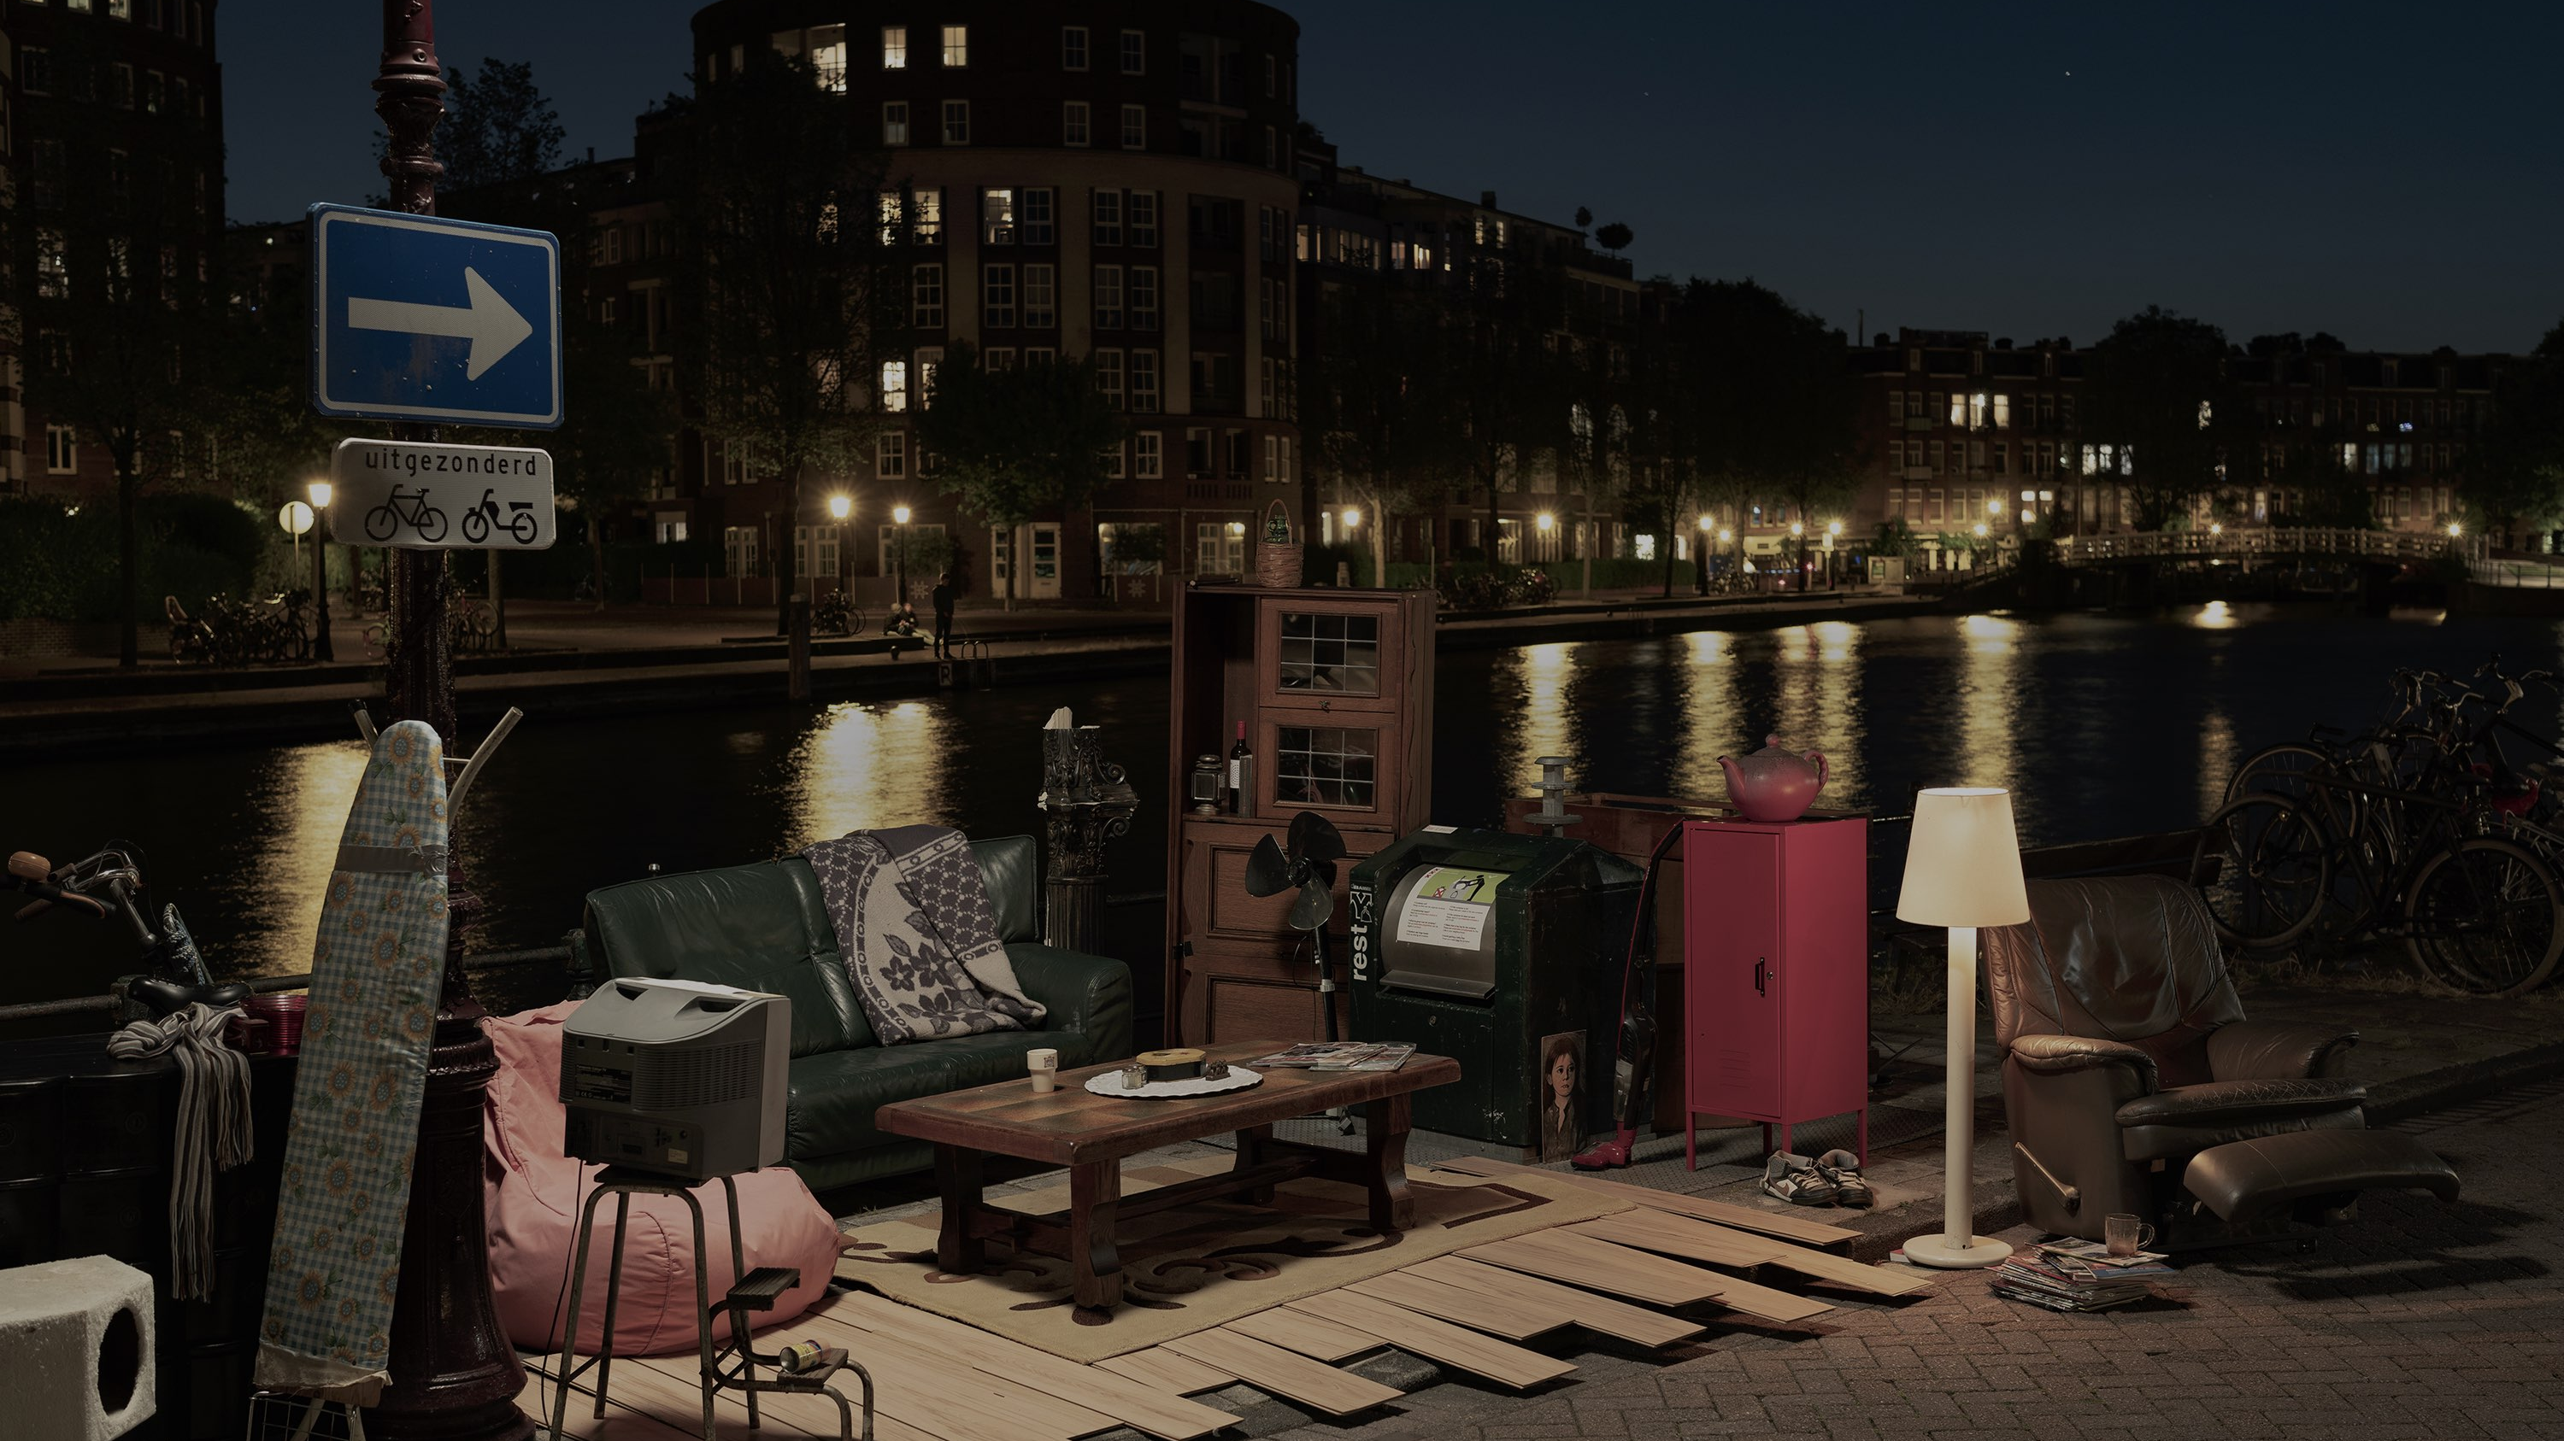
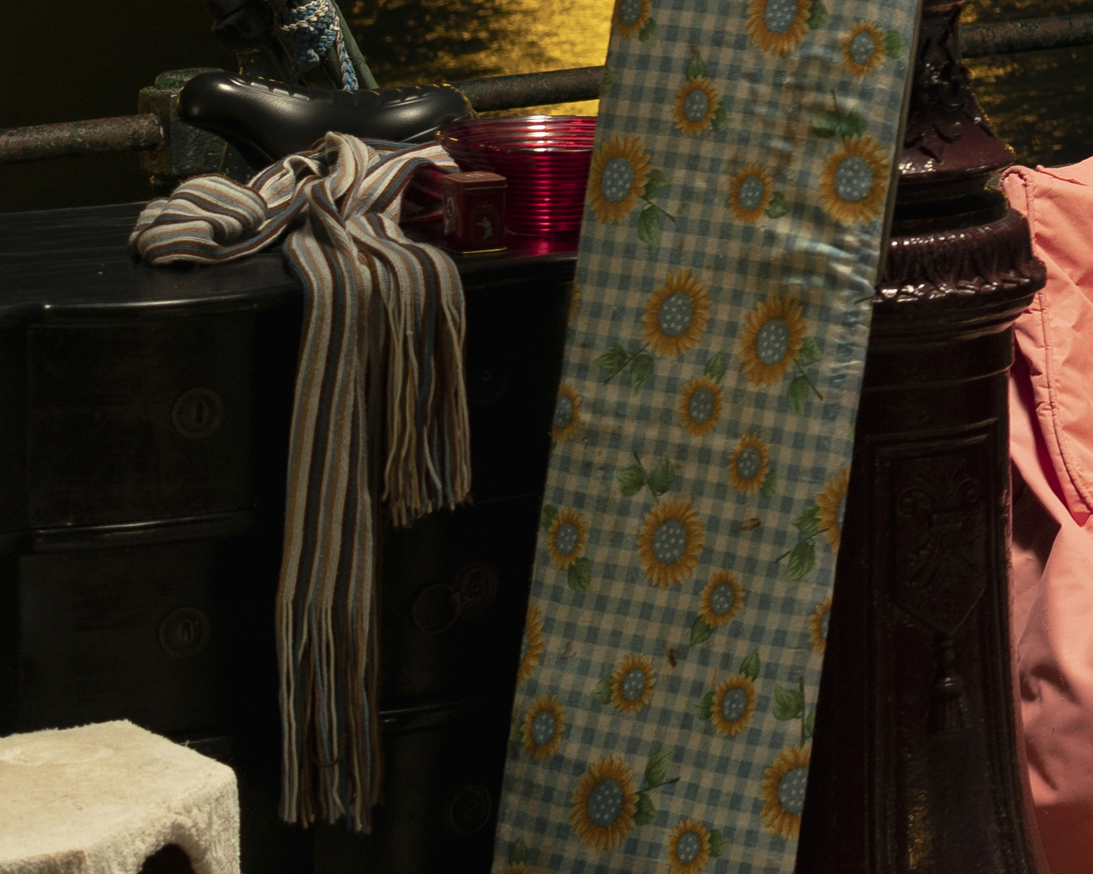
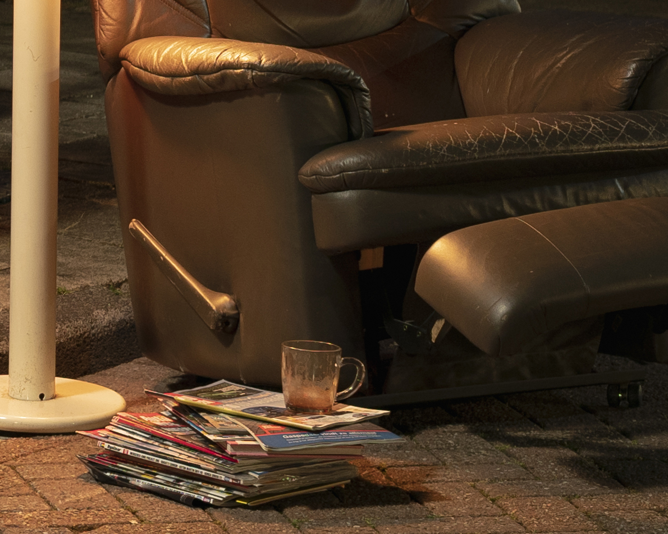

Slide 9
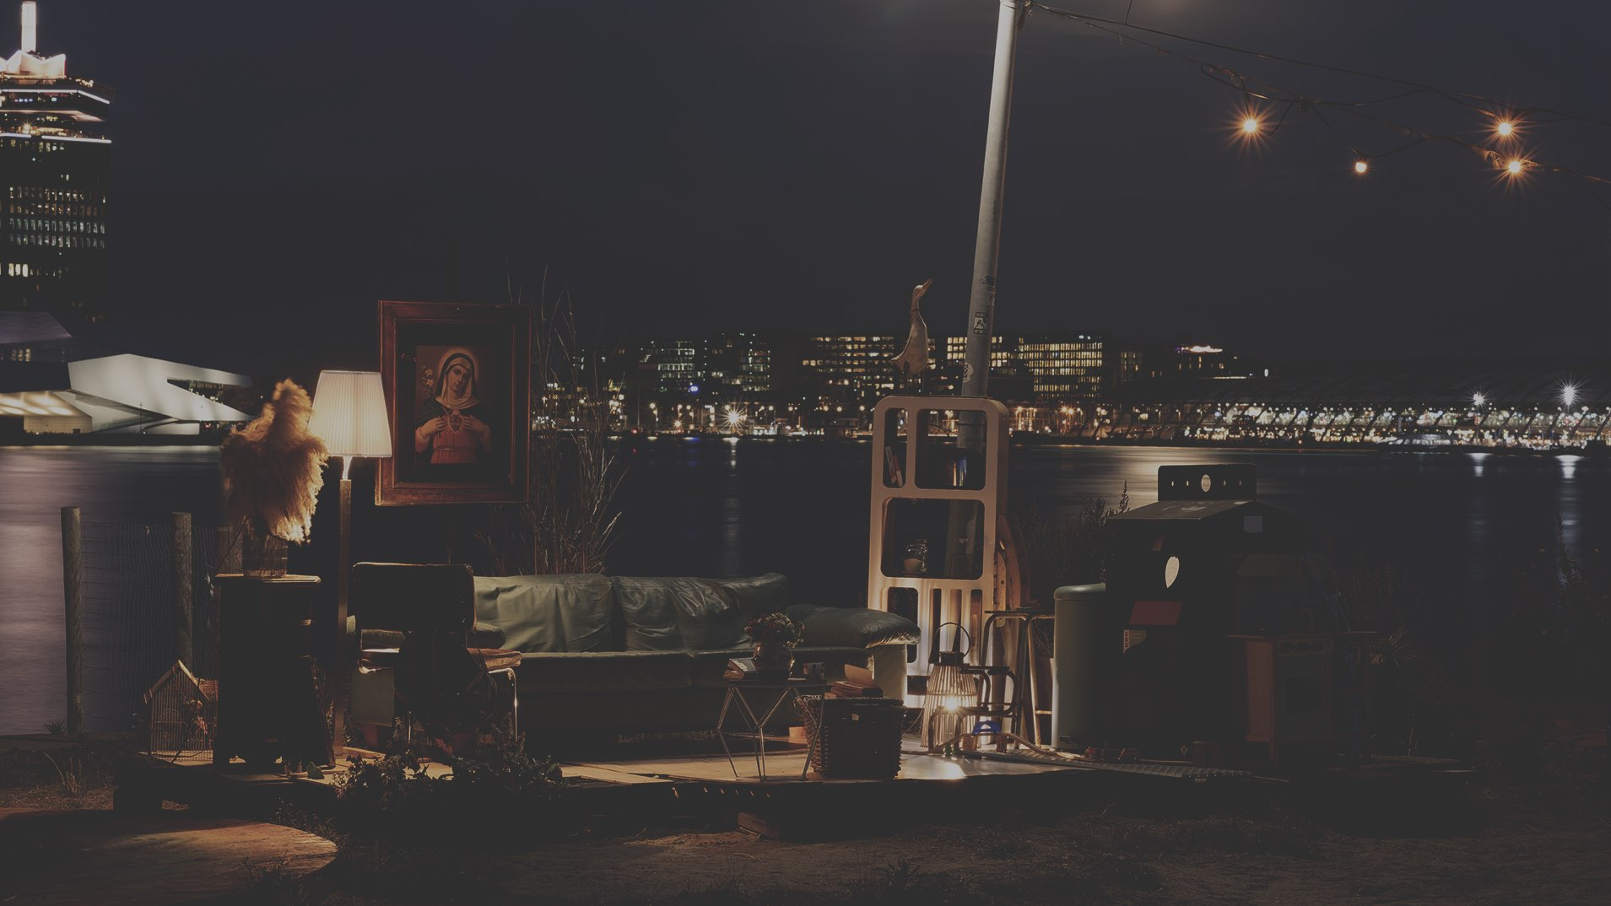
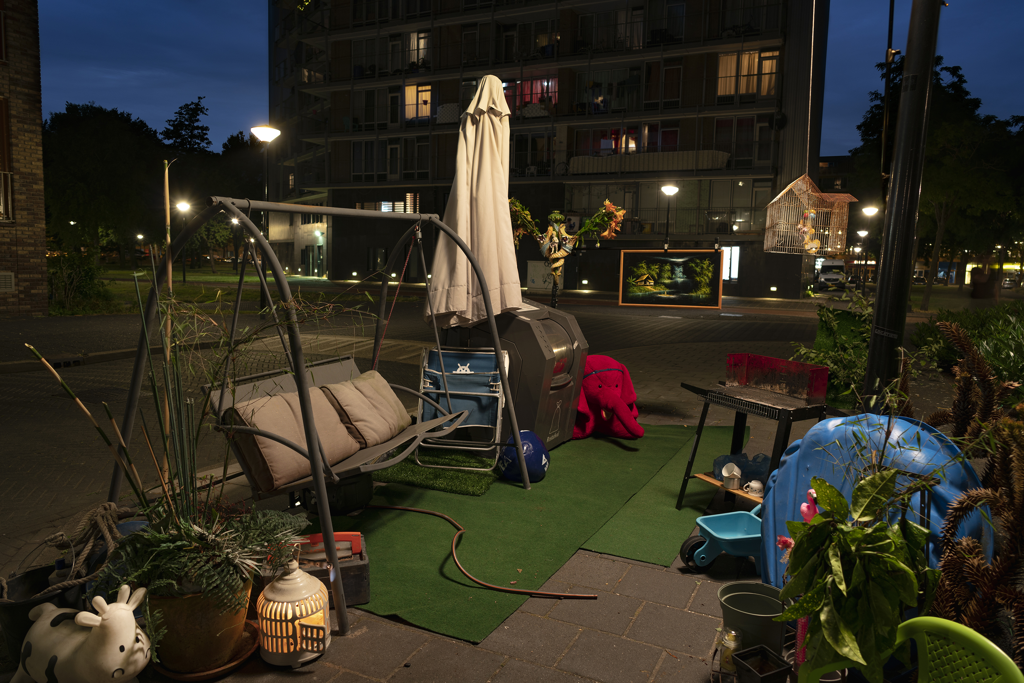
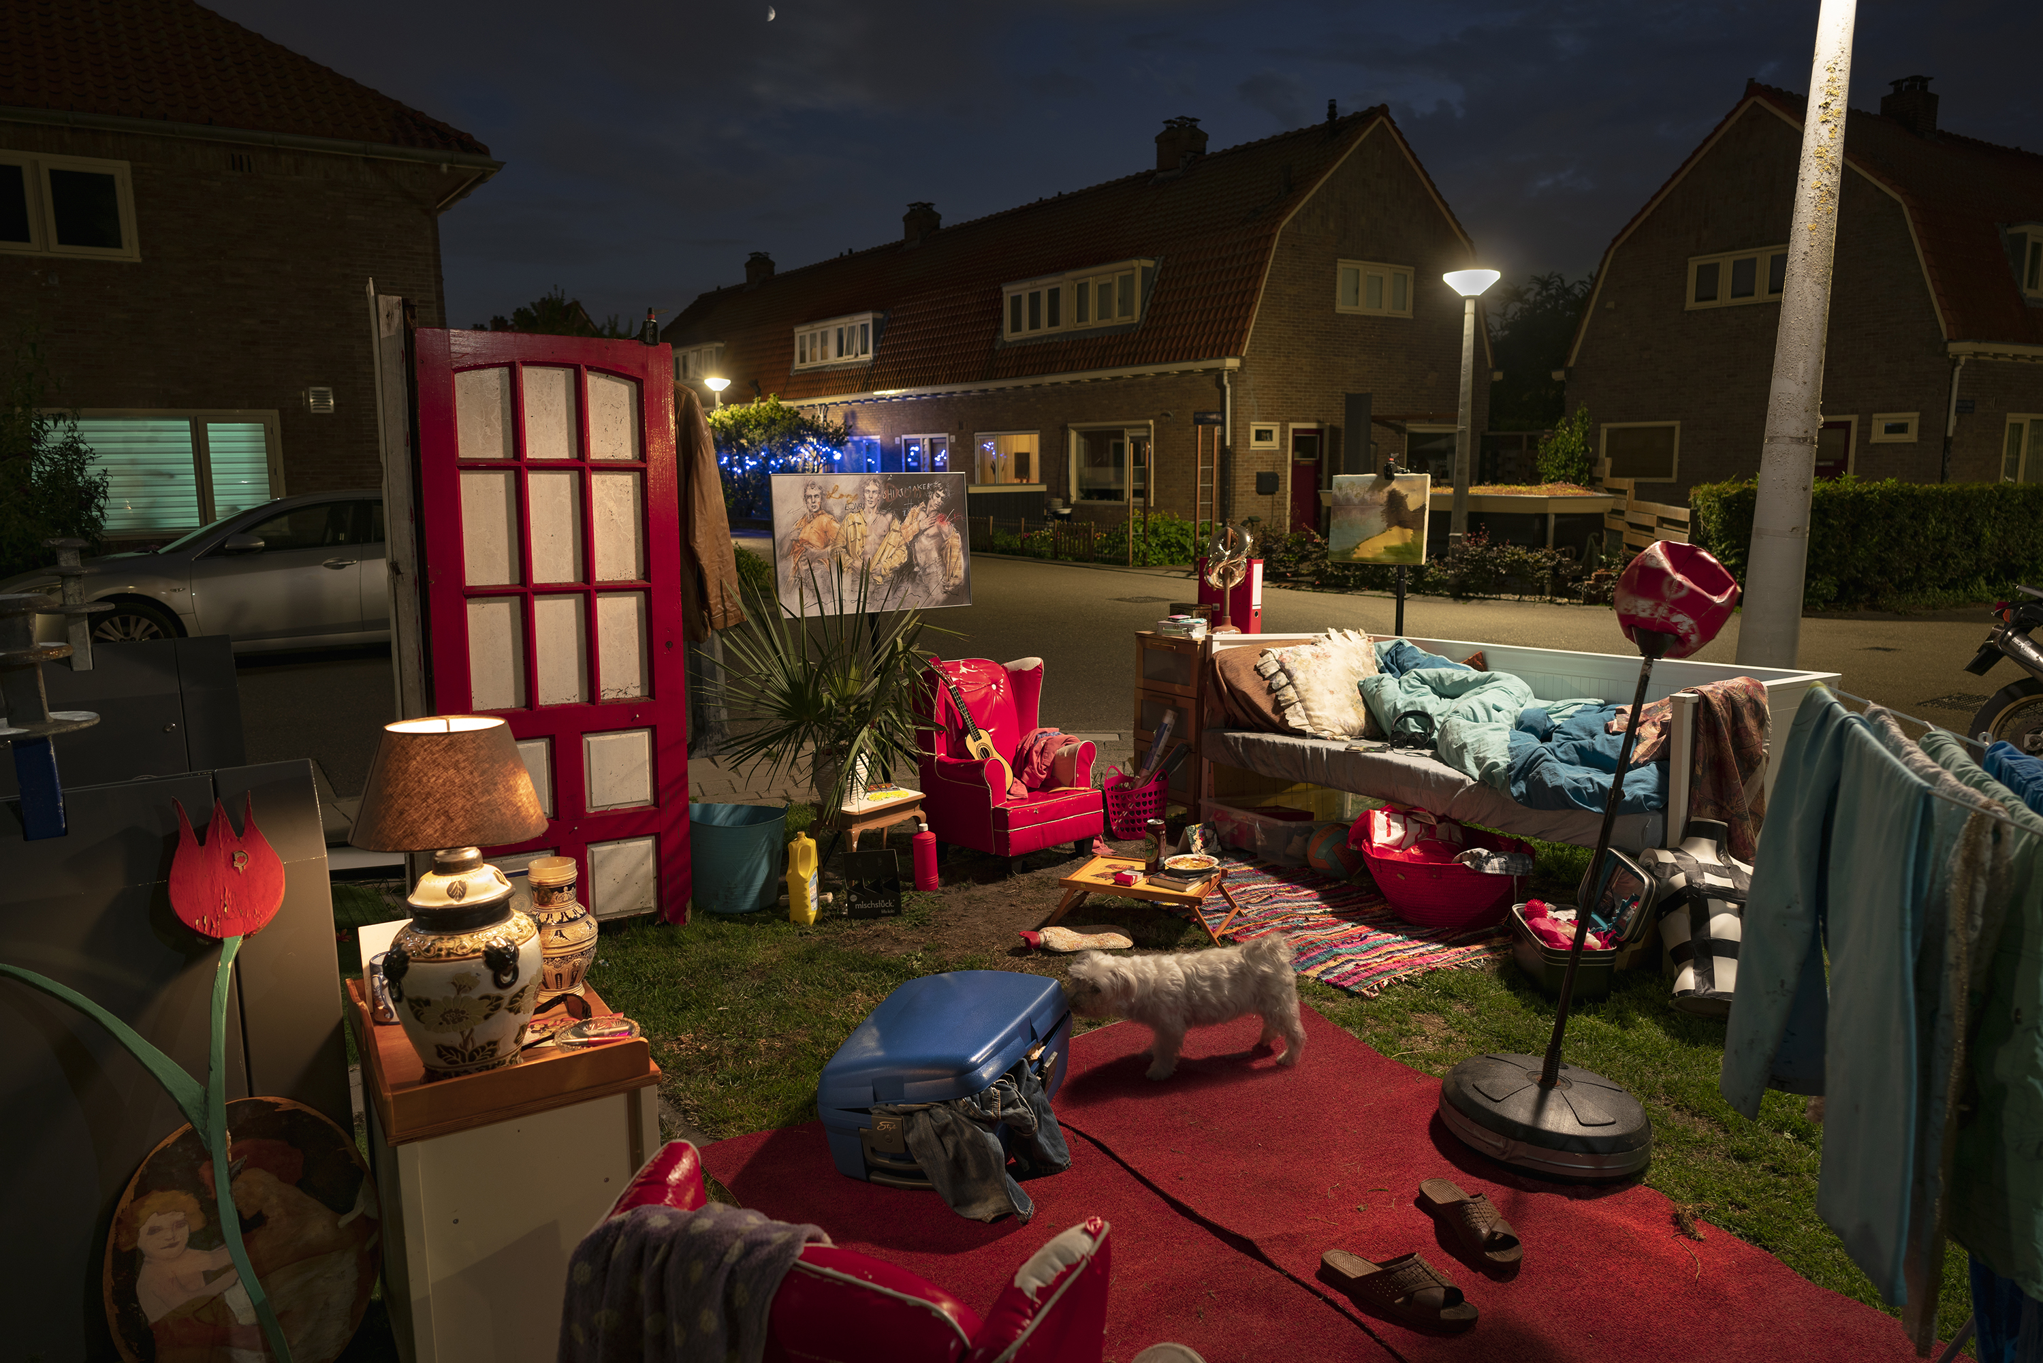
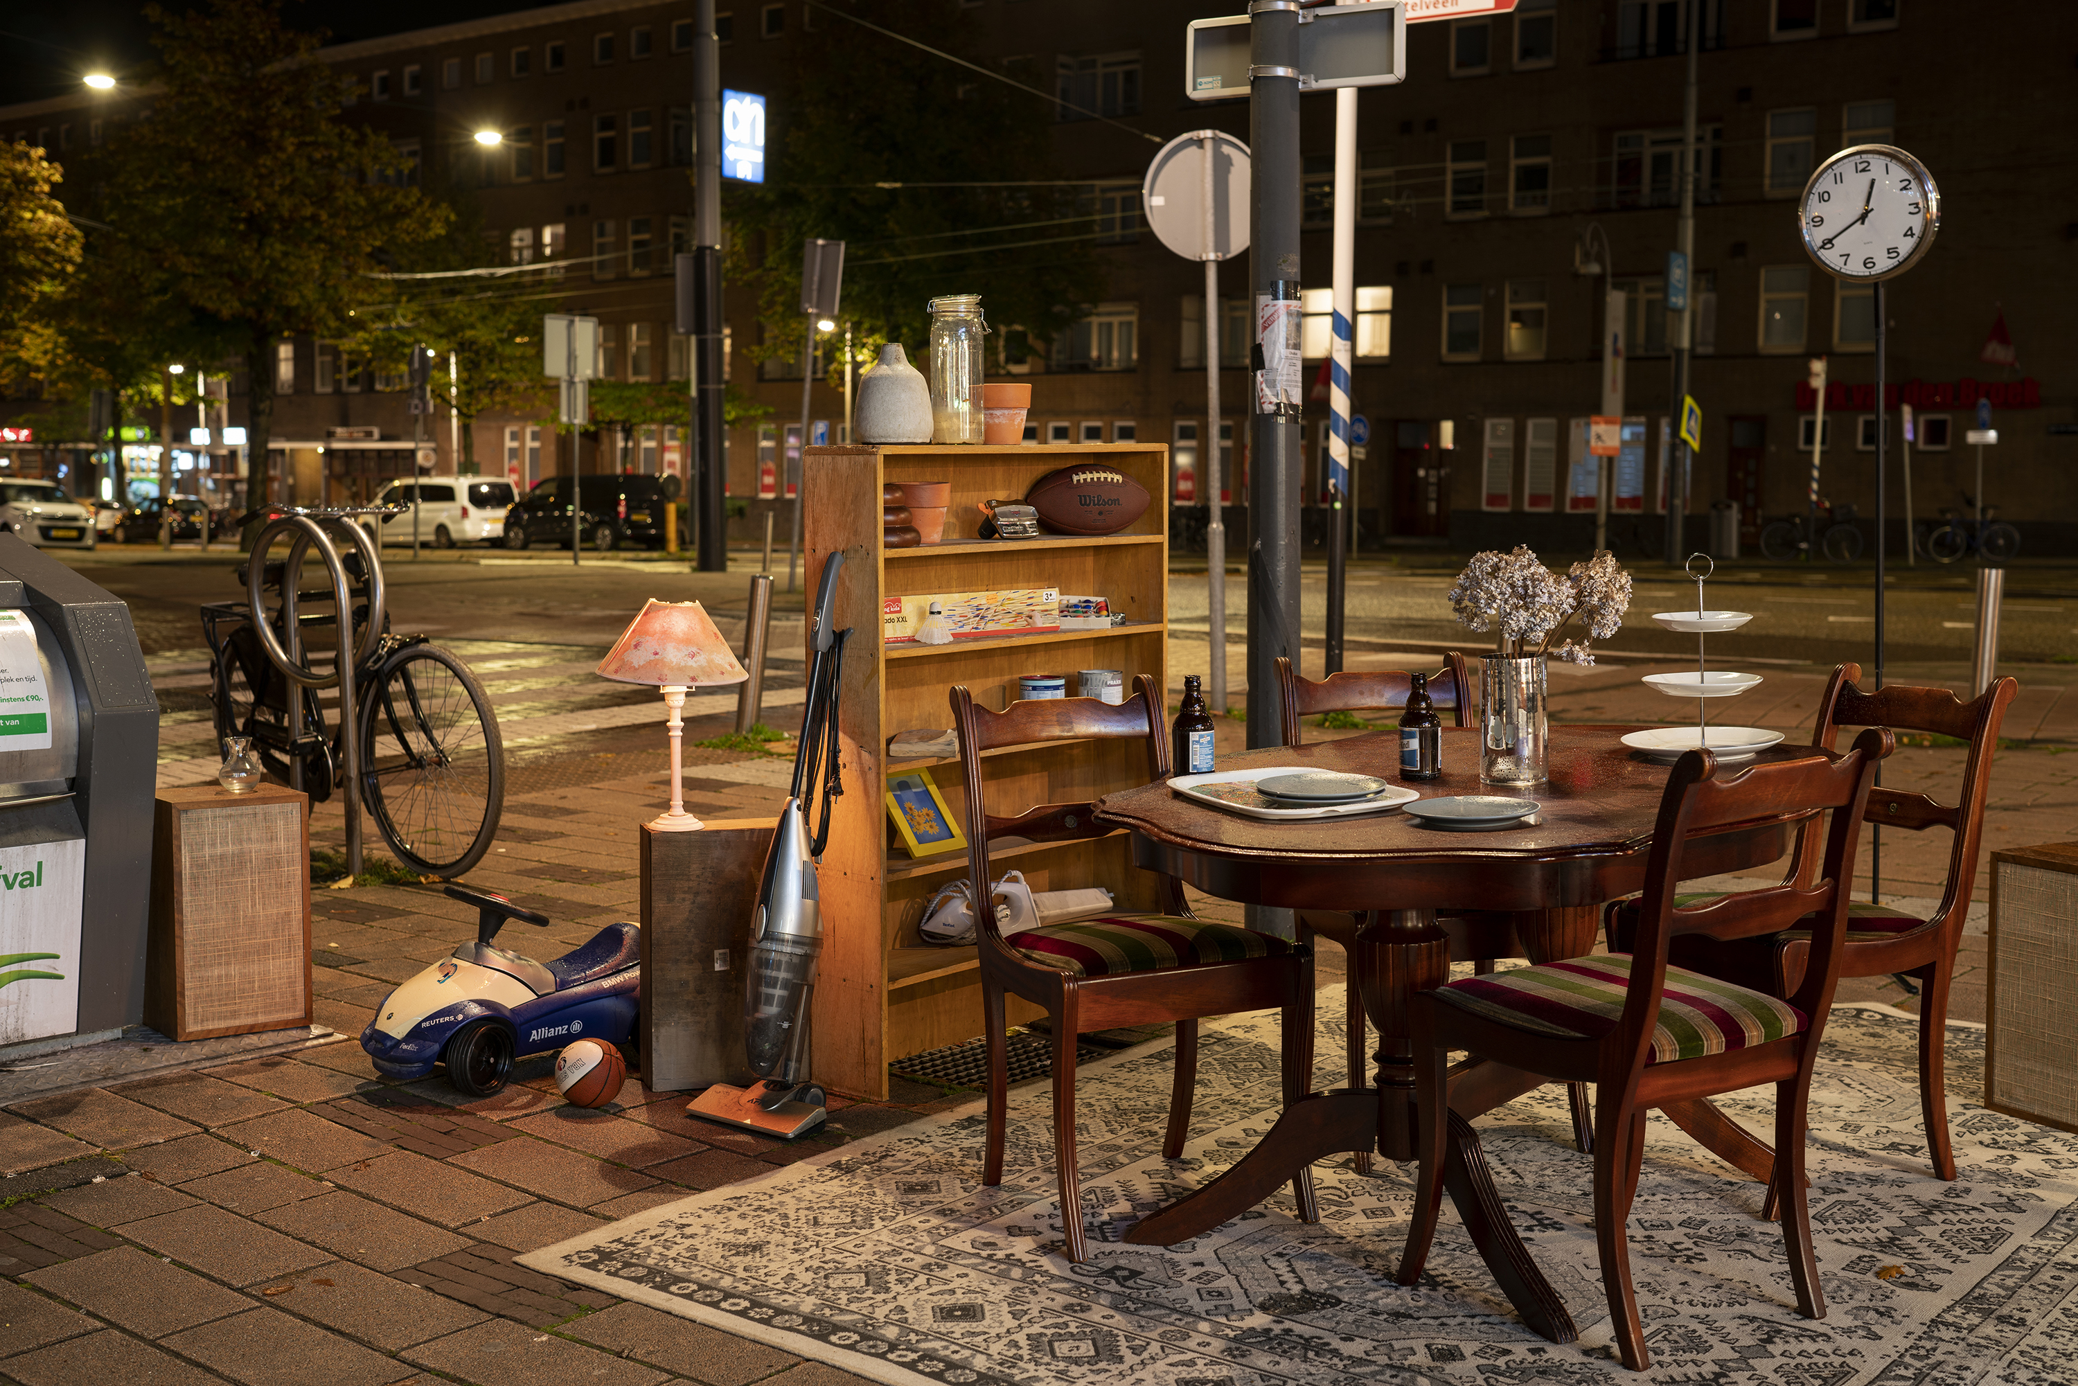
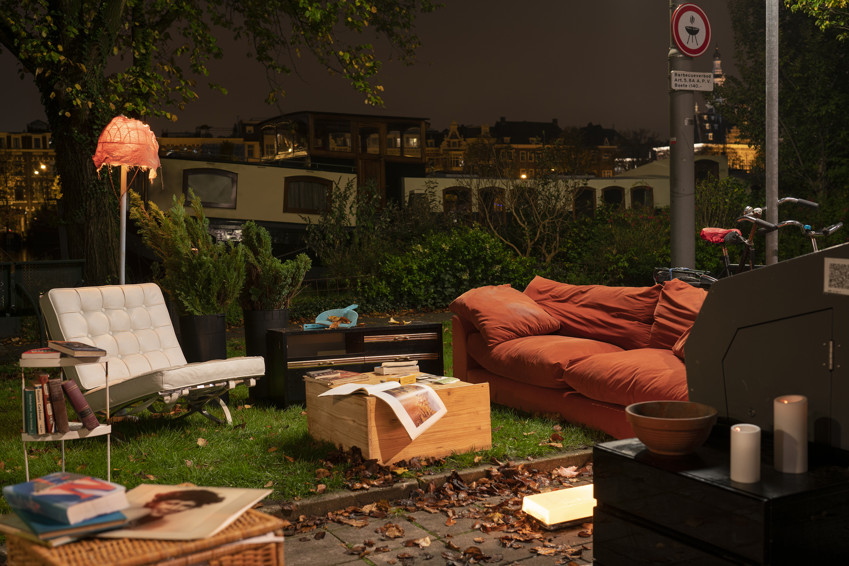
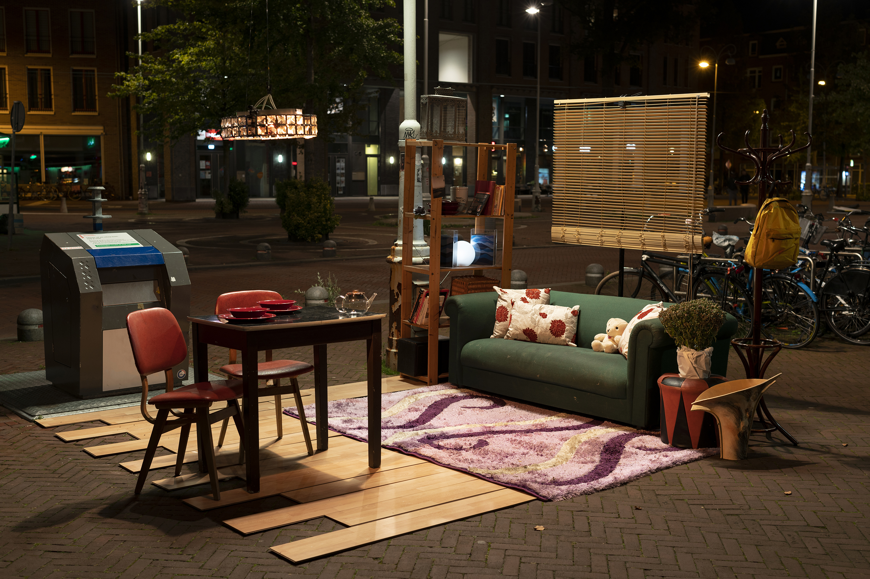

Slide 10
The Challenge
In groups, build an installation with your materials
Use the materials to tell a story
‘Something Old, Something New, Something Borrowed, Something Blue, and Something Not Blue.’
Spaces you can and can't use
Collaboration with photographer and artist
On-demand coaching

Slide 11

Stages & Roles and Creative Thinking Rules
Warming-up and incubation
Ideation
Evaluation
Selection
Reflection
Orientation topic
Rules:
Listen carefully
Write ideas down
Quantity above quality
Freewheel
Pollinate
Do not judge
Roles:
Moderator
Writer
Materials

Slide 12
Writing assignment
Explanation of the assignment
Creative roles to compose teams

Slide 13
Round 1: First draft of installation
Brainstorm ideas: Use a mind map to create one coherent story based on your 6 individual stories
Prototype: Create multiple installations & take pictures with phone
Decide: Choose first composition & define working title installation
Take pictures: Play with different perspectives
Appoint a moderator, writer and manager of the materials

Slide 14
Pitches
One-minute pitch per team
Feedback

Slide 15
Round 2: Final installation
Wildcard (optional): select one student per team to go to the thrift store
Think of what you are missing in your installation
Rest of the group communicate with thrift store visitor by phone
Refinement & iteration of installation
Prepare one-minute pitch
Team pitches, feedback & photo taking

Slide 16
Final installation & pitch
Team pitches installation
Feedback
Photo taking

Slide 17
Reflection & discussion
Challenge experience
Learning outcomes
Reflection on creative roles
Key take-aways
What went well?
What was challenging? How did you manage this?
What can you take from this experience?

